Slide 1
ADDRESSING 5G IN CEPT
Next Generation Mobile Communication Technologies: 5G and Beyond
CEPT ECC Vice Chairman
Jaime Afonso
International Organizations Session
11th International Electronic Communications Regulators Conference
Turkey ICT Summit 2017
Turkey, Ankara, 3-4 May 2017

Slide 2
AGENDA
ECC: what we do
SPECTRUM MANAGEMENT: background
5G: the context
5G IN CEPT: actions and challenges
CONCLUSIONS

Slide 3
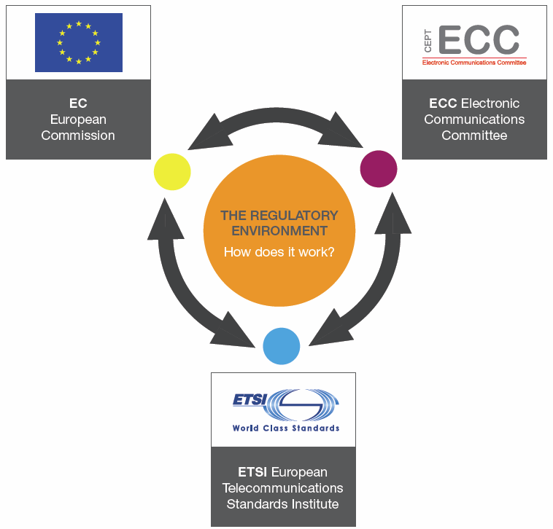
ECC: what we do
  The ECC:
  Brings together representatives from CEPT members (48)
  Develops common policies and regulations
  A focal point for information on spectrum use
  Offers a wide forum for the preparation of the work in ITU
  Cooperates with several bodies
  It has a strategic Plan (2015-2020)
  The major challenges and topics (e.g. 5G, the 700 MHz)

Slide 4

SPECTRUM MANAGEMENT: background the regulatory environment
  Global
  Regional
  National
  National Frequency Allocation Table
  The framework for allocation/assignment

Slide 5
SPECTRUM MANAGEMENT: background in the center of the debate
  Key in various sectoral policies
  The importance of wireless broadband
  Supports high level policy objectives (e.g. Digital Single Market)
  Economic value of the spectrum
  Harmonization and..
  .. multiple technologies/services/applications

Slide 6
5G: the context adressing the capacity ”crunch
Increase Capacity
Efficient technologies
Network densification
Architecture
SPECTRUM
  More spectrum: up to around 2000 MHz (ITU-R M.2290)
  Radio Spectrum Policy Programme: targeting 1200 MHz
  5G: much more spectrum required!
  Contiguous spectrum and large blocks

Slide 7
5G: the context the ”mobile spectrum”
  Harmonised frequency bands in ECC framework
Band | Size (MHz) | ECC framework (main deliverables)
700 MHz (694- 790 MHz) | 2x30 + 20 (option 0 to 4 blocks of 5 MHz) (SDL) | ECC DEC(15)01
800 MHz (790-862 MHz) | 2x30 | ECC DEC(09)03
900 MHz (880-915 MHZ /925-960 MHz) | 2x35 | ECC DEC(06)13
1452-1492 MHz | 40 (SDL) | ECC DEC(13)03
1.8 GHz (1710-1785 MHz/1805-1880 MHz) | 2x75 | ECC DEC(06)13
2 GHz (1920-1980MHz/210-2170 MHz) | 2x60 | ECC DEC(06)01
2.3-2.4 GHz | 100 | ECC DEC(14)02
2.6 GHz (2500-2690 MHz) | 2x70+50 | ECC DEC(05)05
3.4-3.8 GHz | 400 | ECC DEC(11)06
 | Total : 1210 MHz

Slide 8
5G: the context the basics
  The “5G” vision – IMT. 2020
  “5G” as the enabler of different applications, “use cases”
Source: ITU-R Rec. M.2083

Slide 9
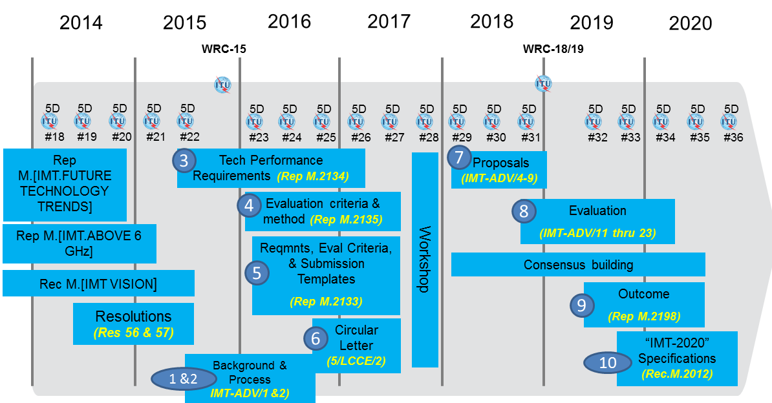
5G: the context
long process for standardization and spectrum

Slide 10
5G: the context the basics
  Much more than “mobile broadband”
  M2M/ IoT requirements needs to be considered

Slide 11
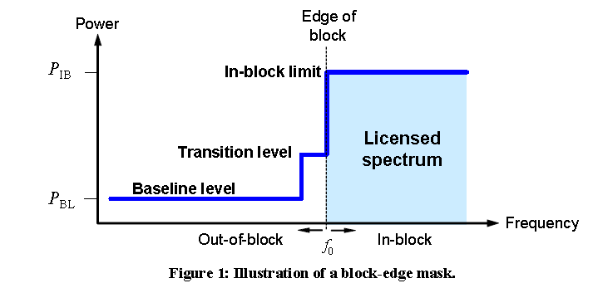
5G: the context the existing spectrum
  Flexible use of the spectrum
  Different mobile systems are implemented (e.g. GSM, UMTS, LTE)
  Technical conditions (LRTC) based on BEM (Block Edge Mask)
  Implemented in several “MFCN bands” (e.g. 3.5 GHz, 2.6 GHz, 700 MHz, 800 MHz and 2.1 GHz)

Slide 12
5G IN CEPT: actions and challenges the roadmap
  Developed in close cooperation with stakeholders
  CEPT Roadmap for 5G”¹ outlines the CEPT’s actions for 5G
  Harmonisation of frequency bands (arrangements, technical conditions)
  Objectives in the context of the preparation of WRC-19
  Verticals (the different use cases)
  Other spectrum challenges (e.g. the use of higher bands)
  Work items currently being addressed in CEPT ECC
  ¹http://www.cept.org/Documents/ecc/35302/ecc-17-034-annex-05_roadmap-for-5g-march-2017

Slide 13
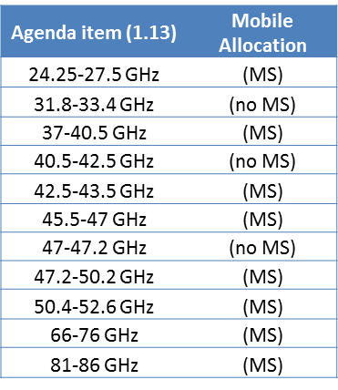
5G IN CEPT: actions and challenges the spectrum
  “5G” in the context of WRC-19
  Extensive use (fixed, satellite, passive, radars, etc..)
  IMT spectrum needs and sharing/compatibility studies on the way
  Current focus in the frequency bands 24.25-27.5 GHz, 31.8-33.4 GHz and 40.5-43.5 GHz
  Current priority: 24.25-27.5 GHz band before WRC-19
  The 27.5-29.5 GHz band is in use for broadband satellite, i.e. not available for 5G

Slide 14
5G IN CEPT: actions and challenges in the context of European Union
  High level objectives (e.g. “Gigabit society and Action Plan for “5G”) targeting 2025 (2020 as intermediate step)
  The Radio Spectrum Policy Group opinion on 5G:
  3.4-3.8 GHz as a primary band for introduction of 5G
  Deployment also in spectrum below 1 GHz (e.g. 700 MHz)
  24.25-27.5 GHz as a pioneer band above 24 GHz
  European Commission Mandate to CEPT on 5G
  3.4 – 3.8 GHz: ECC Decision(11)06 reviewed to assess its suitability to 5G;
  24.25-27.5 GHz: channeling arrangements and technical conditions for 5G

Slide 15
5G IN CEPT: actions and challenges other issues to be considered by CEPT
Requirements of vertical industries in the context of 5G (e.g. PPDR, industrial automation, automotive, utilities, rail, …)
Issues such as satellite solutions for 5G, new sharing opportunities and challenges (e.g. MIMO),infrastructure and backhaul requirements for 5G.
Machine to Machine requirements
  Could be implemented in any mobile MFCN band, PMR or License exempted band/Short Range Devices
  L Band “extension” (1427-1452 and 1492-1518 MHz)
  EC mandate for the provision of SDL to suit for 5G

Slide 16
CONCLUSIONS
  5G spectrum: spectrum above 6 GHz and …below
  Harmonized, contiguous and large bandwidths needed
  Machine-to-Machine spectrum requirements
  Cognitive technology and new sharing solutions
  Some spectrum should also remain available for other usages, e.g. Galileo, GMES, PPDR, RFID, PMSE
  Standardization and global harmonization is key

Slide 17
ADDRESSING 5G IN CEPT
 | Web: www.cept.org/ecc
ECO Nyropsgade 37, 4 DK-1366 Copenhagen Tel: +45 33 89 63 00
“Next Generation Mobile Communication Technologies: 5G and Beyond”
11th International Electronic Communications Regulators Conference
Jaime Afonso
Turkey, Ankara, 3-4 May 2017

